Slide 1
02 | PowerShell’s Scripting Language
Jeffrey Snover | Distinguished Engineer & Lead Architect
Jason Helmick | Senior Technologist, Concentrated Technology

Slide 2
Module Overview
Variables
Quotation Marks
Object members and variables
Parentheses
Logical constructs
Looping constructs

Slide 3


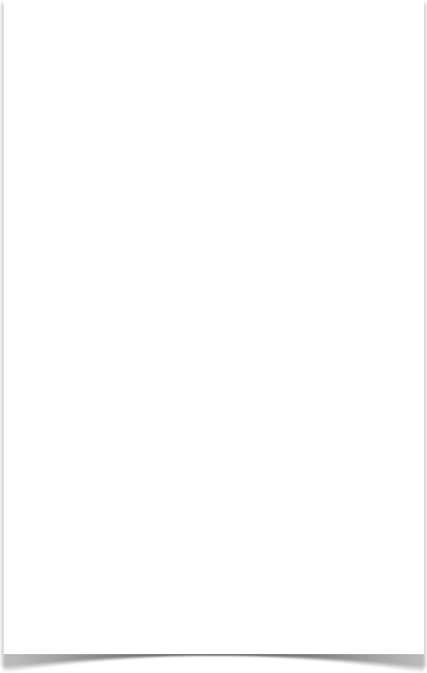
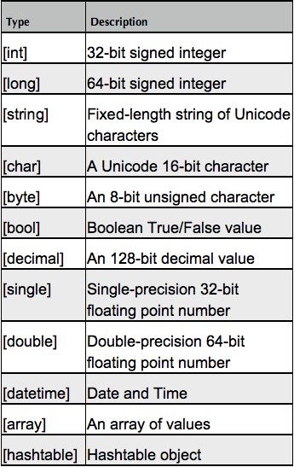
Variables: A place to store stuff
Use $ to create and use variables
Can contain letters, numbers, spaces and underscores
Don’t persist after Shell exits
New-Variable
Set-Variable
Get-Variable
Clear-Variable
Remove-Variable
Can force a type – [int]$var
Note: The $ is not part of the variable name, it’s a cue to access the contents of the variable

Slide 4
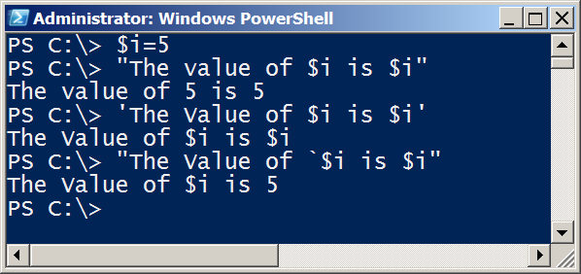
Quotation Marks
Double Quotes resolve all variables
Can use Sub-Expressions
Single Quotes prevent substitution
Get-Help About_Quoting_Rules
Back-tick/Grave-Accent prevents individual substitution

Slide 5
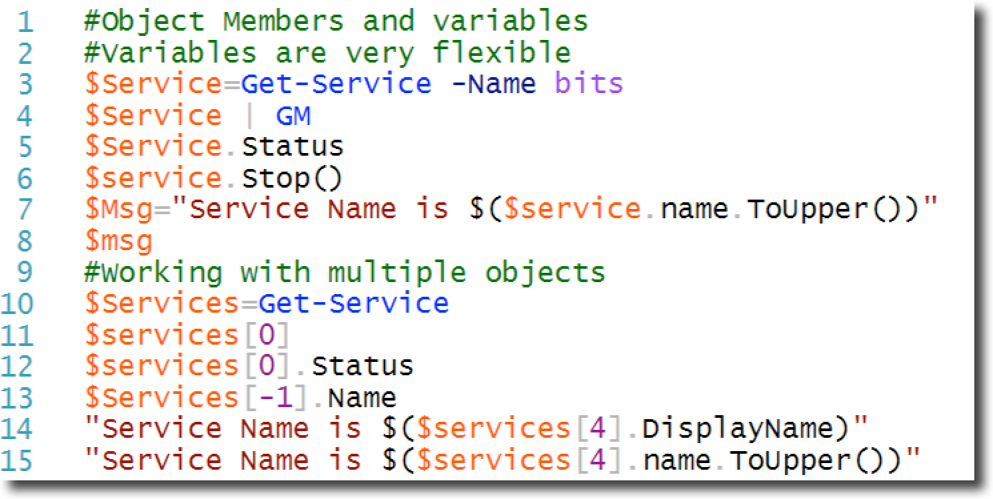
Object Members and variables
Remember-Get-Member (gm) will provide the TypeName, Methods and Properties of an Object.
You can use variables to work with Objects

Slide 6
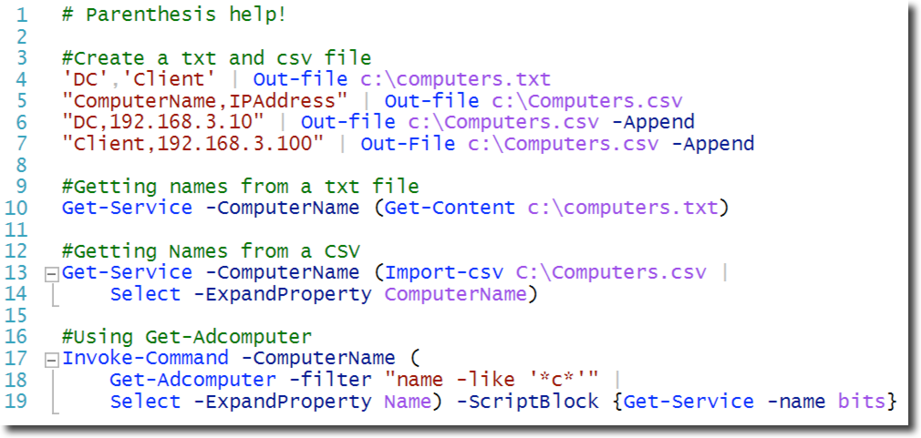
Parentheses

Slide 7
Logical construct

Slide 8
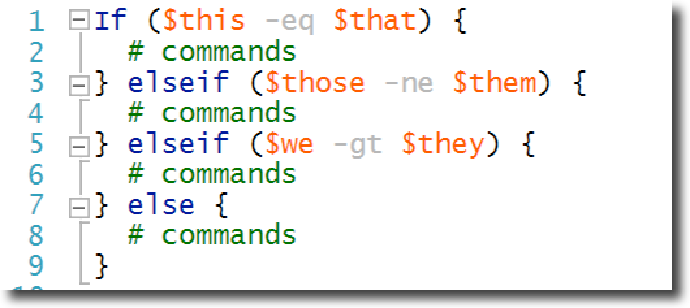
Logical construct - If..ElseIf…Else

Slide 9
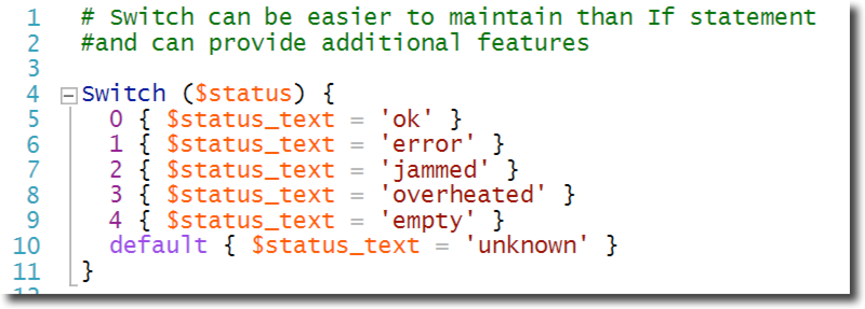
Switch construct – Switch

Slide 10
Looping constructs

Slide 11
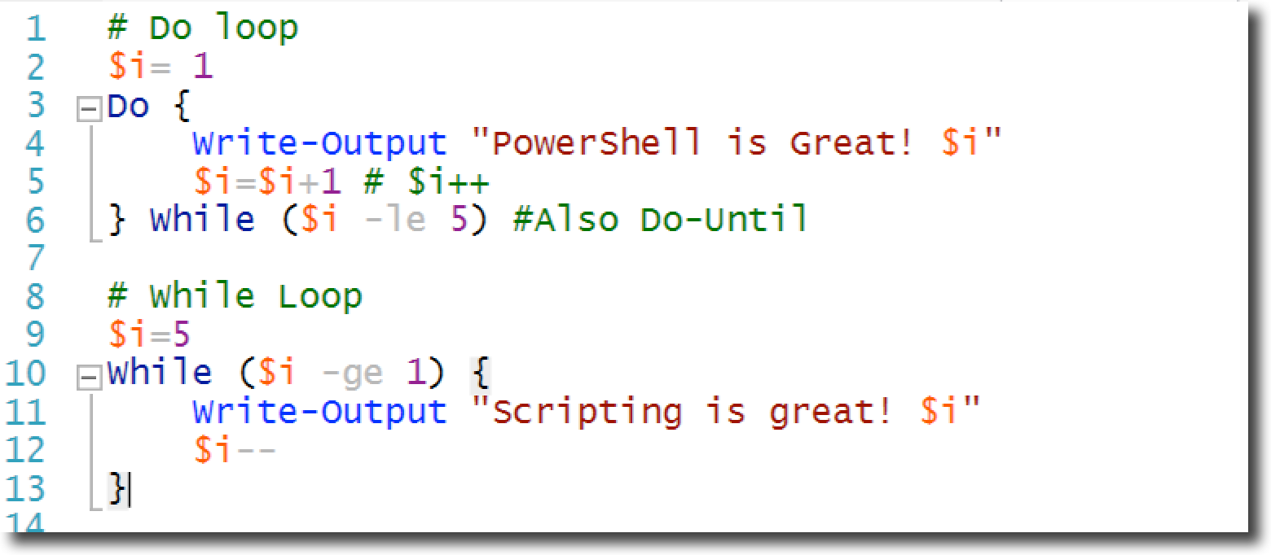
Looping constructs

Slide 12
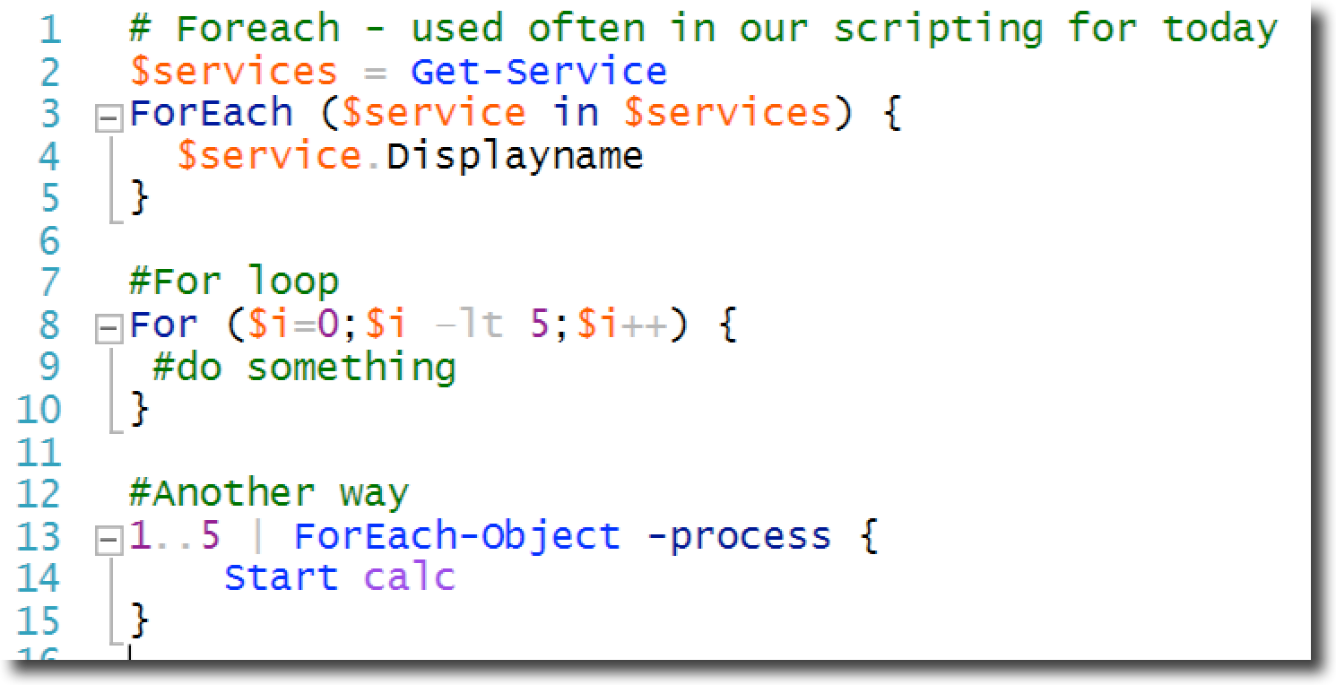
Looping constructs

Slide 13
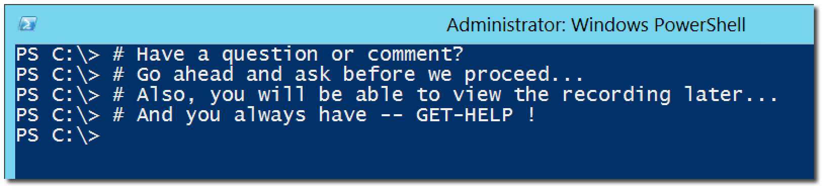
Questions or comments?

